Slide 1
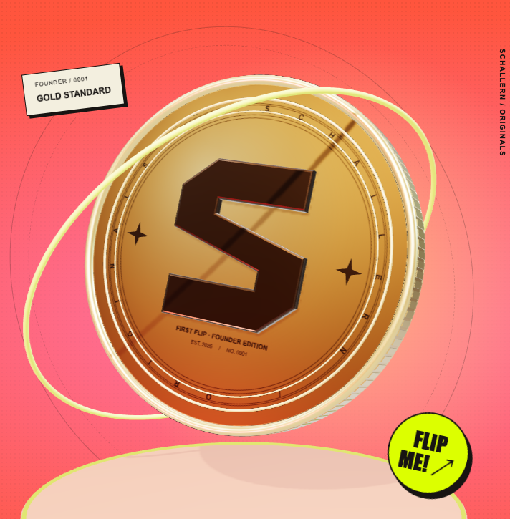
SCHALLERN
THE NEXT CHAPTER / $1.7M FUNDING PLAN
ONE THROW.
YOUR WORLD.
Before Apple Pay,
there was milk money.
The schoolyard game, reimagined
for a global gaming community.
A PLAYABLE DEMO. A BRAND TO BUILD.
01
Notes:
Schallern is in development. The $1.7 million figure is the confirmed financing target, not money already raised. Visual: actual 3D coin from the approved E mockup.
Sources: Mint_Website_Plan/Mockups/E_Flip_The_World/Vorschau/Start_EN.png; 03_Ergebnisse/Investoren_Pakete/03_PREIS_UND_RUECKFLUSS.md

Slide 2
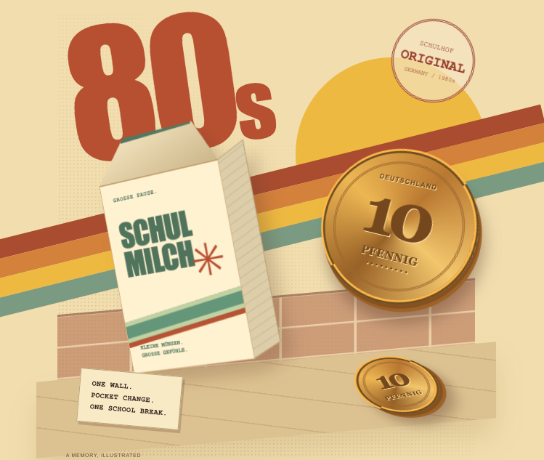
SCHALLERN
GERMANY / THE 1980s
FROM KAI'S CHILDHOOD
THE STAKES?
MILK MONEY.
A schoolyard wall. A few friends.
Pfennig coins meant for school milk.
Closest to the wall took the coins.
Lose, and some days there was no milk.
Small change. Big feelings.
Kai Zimmer · Founder
02
Notes:
Kai's direct account is the source of the milk-money story. The 1980s describe his childhood, not the invention of coin-tossing games. The artwork is an illustration, not an archive photo.
Sources: User conversation, 15.10.2026; Mint_Website_Plan/Mockups/E_Flip_The_World/STORY_80S.md; Mint_Website_Plan/Mockups/E_Flip_The_World/Vorschau/Story_EN_1440.png

Slide 3

SCHALLERN
THE GAME
CLOSEST
WINS.
01 / AIM
Choose direction and arc.
02 / FEEL
Pull for power. Release to flip.
03 / LAND
Bounce. Slide. Settle.
Playable demo with local AI opponents. Six-player online matches are the planned next format. Scene: arena concept.
03
Notes:
The current demo proves a local game loop, not a production multiplayer service. Throwing distances use metres and centimetres; the closest resting coin edge decides. New distances are shared fairly by all players in a round.
Sources: Demo-Grafiken/V03-Claude; Mint_Website_Plan/Mockups/E_Flip_The_World/index.html; Mint_Website_Plan/Mockups/D_Street_Legends/assets/hero.jpg

Slide 4
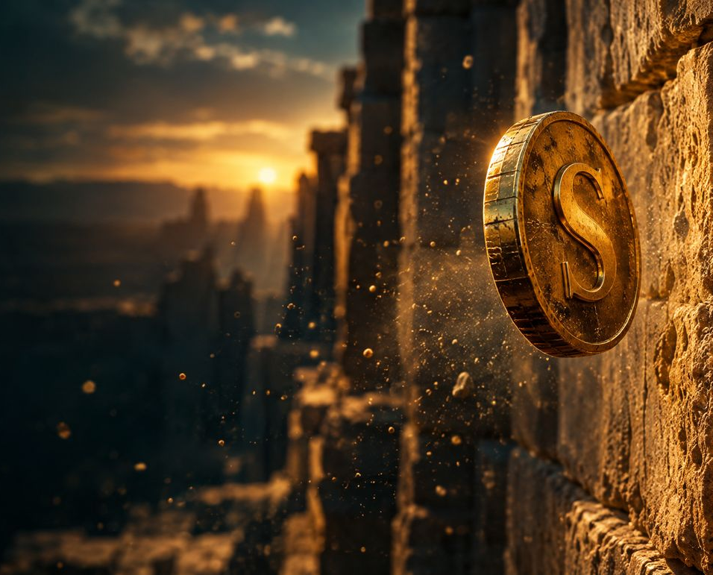
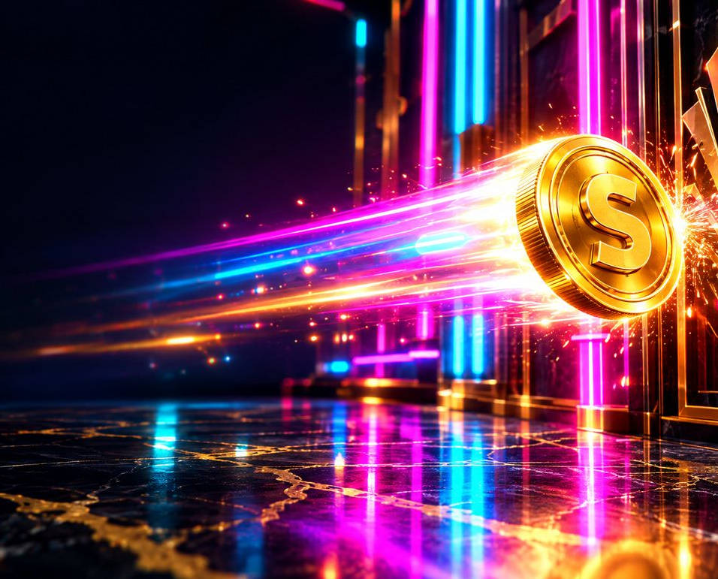
SCHALLERN
THE WORLDS
NEW WALL. NEW FEEL.
BERLIN
GIZA
LAS VEGAS
Asphalt · Bounce
Sand · Short rollout
Marble · Long slide
Each surface changes the throw. New round distances keep players adjusting. Arena concept art.
04
Notes:
Images are the same arena concepts used in the E mockup. The current game has separate physics settings for asphalt, sand and marble. No claim that a real-world landmark partnership exists.
Sources: Mint_Website_Plan/Mockups/D_Street_Legends/assets/hero.jpg; Mint_Website_Plan/Mockups/D_Street_Legends/assets/giza.jpg; Mint_Website_Plan/Mockups/D_Street_Legends/assets/vegas.jpg; Demo-Grafiken/V03-Claude

Slide 5
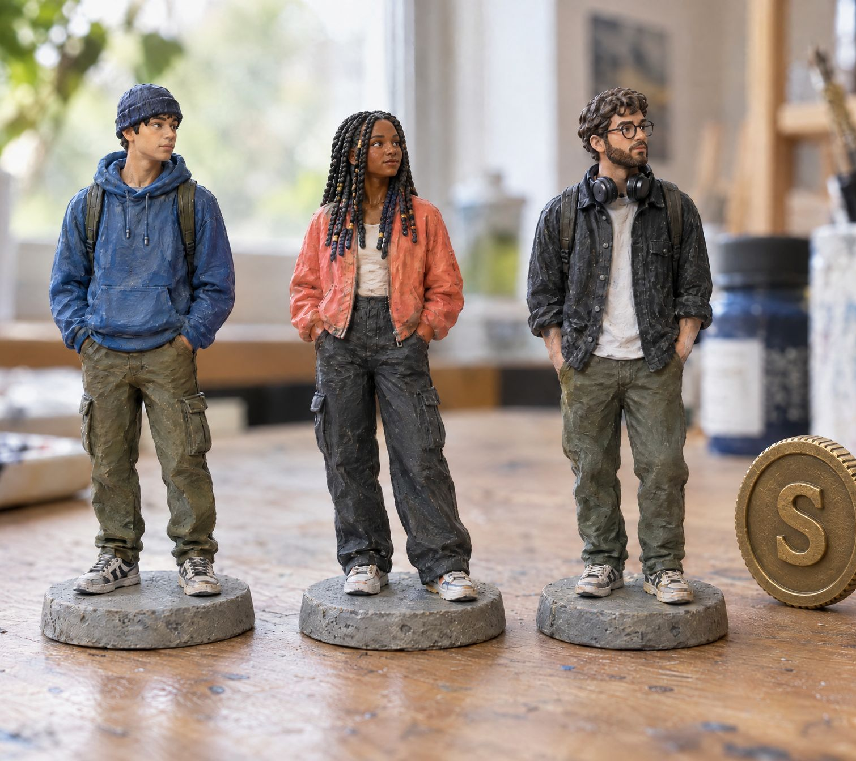
SCHALLERN
PLAY / COLLECT / BELONG
YOUR COIN.
YOUR CREW.
Own your look
Finishes, colours and character.
The same fair physics for everyone.
Beyond the screen
Personal 3D-printed figures
and physical coins are the vision.
COLLECTIBLE CONCEPT · NOT YET FOR SALE
05
Notes:
Figures are a product concept from the same mockup asset set, not photographed manufactured products. Cosmetics, collectibles and events are expansion opportunities, not extra revenue silently added to the existing financial forecast.
Sources: Mint_Website_Plan/Mockups/Website/img/B_figuren.jpg; Mint_Website_Plan/Mockups/E_Flip_The_World/index.html

Slide 6
SCHALLERN
REVENUE LOGIC / PLANNED PAID MODE
THE PLAYERS PLAY.
THE GAME EARNS.
6 × $1
$5.50
$0.50
Six players · $6 pot
Winner payout
House fee
10% DIRECT CREATOR FEE¹
Then 50% NFT pool / 50% company²
House fee = 10% of the winner’s gain before fee ($6 − $1). ¹ On adjusted attributed house fees. ² On distributable profit after costs, loss recovery and tax reserve.
06
Notes:
Example: 6 × $1 = $6. Winner gain before fee $5; fee $0.50; payout $5.50. Affiliate is an expense before profit, not a third share of the same base. All 10,000 NFTs together receive 50% of distributable profit. The company retains the other half; no equity cash dividends are modelled in years 1–3.
Sources: 03_Ergebnisse/Marketing_Affiliate/05_FINALE_VERTEILUNG.md; 03_Ergebnisse/Marketing_Affiliate/06_MARKTPRUEFUNG.md

Slide 7
SCHALLERN
GROWTH / DIRECT CREATOR PARTNERS
YOUR COMMUNITY.
OUR NEXT PLAYERS.
10 %
36 MONTHS
of adjusted house fees
from attributed players
from each player’s first settled
real-money game · one level
PERSONAL LINK + CODE
CREATOR → DEMO → DISCORD
MONTHLY SETTLEMENT
30-day click window.
Code wins; attribution at signup.
Play, give useful feedback,
join challenges and return.
By the 15th; $25 minimum.
Separate fees for agreed videos.
Demo links track activity now. Commission starts only after approval and real-money launch. Adjusted fees = house fees less reversals and cash bonuses; not stakes or deposits.
07
Notes:
The affiliate program is part of the marketing plan, not an additional payout from the player pot. Direct creators receive 10% of attributed adjusted house fees for 36 months from a player’s first finally settled paid game. One level, 30-day last-valid-link attribution; entered code takes priority and assignment becomes fixed at signup. Monthly settlement by the 15th of the next month with a $25 threshold and carry-forward. Negative player balances carry forward. Personal links, applications and demo tracking are live; a production commission ledger, partner dashboard and payouts are still future real-money work. The year-one $400k marketing budget remains unchanged; agreed video fees must come from that budget. No signed creator deals or typical earnings claimed.
Sources: https://schallern.io/partners.html; https://schallern.io/legal.html#partners; 03_Ergebnisse/Marketing_Affiliate/05_FINALE_VERTEILUNG.md; 03_Ergebnisse/Marketing_Affiliate/07_UMSETZUNG_WEBSITE_UND_SYSTEM.md

Slide 8
SCHALLERN
THE FUNDING PLAN
$1.7M. A CLEAR PLAN.
$1.55M
10,000 NFTs
$150k
Company equity
USD plan at full funding. Budget includes year-one fixed costs and reserves, calculated without fee revenue. No funds are claimed as raised.
08
Notes:
Use of funds (USD): 491,000 prelaunch = 200,000 structure/legal + 200,000 development + 50,000 security + 10,000 mint operations + 31,000 mint distribution. Plus 400,000 marketing + 360,000 fixed costs + 210,000 reserve + 239,000 additional buffer = 1,700,000. These are estimates, not supplier quotes.
Sources: 03_Ergebnisse/Investoren_Pakete/03_PREIS_UND_RUECKFLUSS.md

Slide 9
SCHALLERN
MODELLED BASE CASE / USD
GROW THE GAME.
REINVEST THE RETURN.
HOUSE-FEE REVENUE
$176.60
Three-year cash per NFT
in the base case
Year 1: $0.72
Year 2: $66.35
Year 3: $109.53
Marketing reinvestment: $400k → $407k → $1.071m
Unvalidated targets: $25 CAC, 85% monthly retention, 30% daily activity, 18 games/day, $3 stake. NFT cash: downside $0 / base $176.60 / upside $608.96. Cash ≠ net investment profit.
09
Notes:
Forecast, not actual performance. Years refer to operating years; the valuation assumes 12 months of development beforehand. Fee revenue is not stakes or deposits. Retention and activity assumptions are not proven. No NFT resale proceeds or equity dividends included. Downside is an operating scenario, not maximum possible loss. Full base-case values are taken without changing the model.
Sources: 03_Ergebnisse/Investoren_Pakete/Preis_Rueckfluss_Modell.json

Slide 10
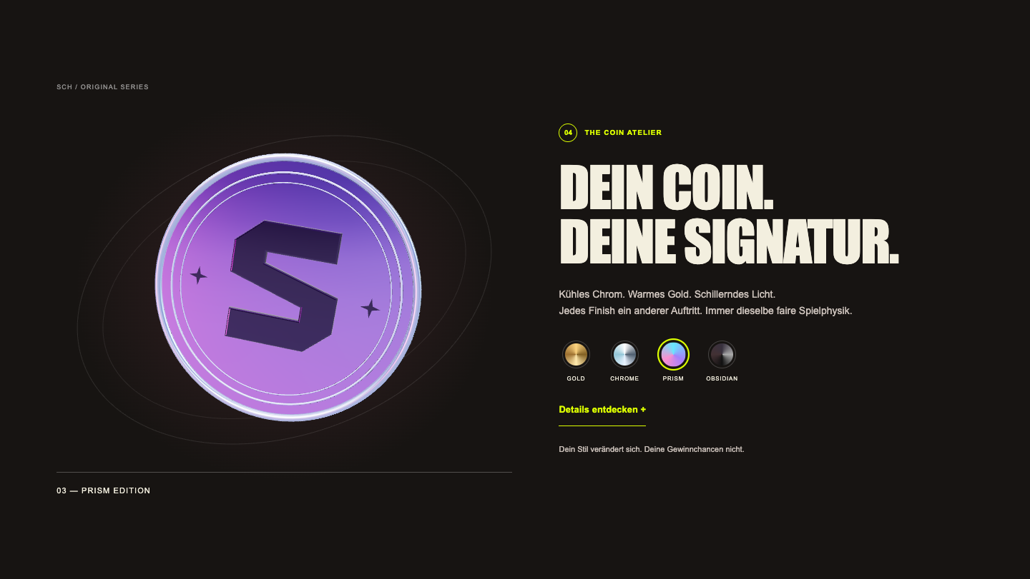
SCHALLERN
PRODUCT ROADMAP
PLAYABLE NOW.
MORE TO BUILD.
NOW
Demo + creator links + Discord.
Feedback: 10 → $5 · 20 → $10 total.
NEXT
Review useful feedback; build online multiplayer and reliable settlement.
BEFORE PAID LAUNCH
Operator structure, applicable permissions,
security review and payment integration.
Future bonus play credit · $10/person · $5k total.
No deposits, withdrawals or real-money play today.
10
Notes:
Demo feedback: 10 distinct qualified submissions earn a $5 bonus-credit voucher; 20 earn another $5 ($10 total). At most two qualified submissions daily, team review, $10/person and $5,000 program cap. Personal codes are delivered via Discord, redeemable only at the real-money launch in the player’s region. Bonus principal cannot be withdrawn; it must be wagered once in full before winnings can be withdrawn. Codes expire 12 months after regional launch and lapse if it never launches. No current cash payout. Daily code ledger exists; actual regional redemption is future work. This separates present demo capabilities from funded production work. No delivery date or licensing completion is claimed. The illustrative 12-month development period belongs to the valuation model and is not a promised launch date.
Sources: Demo-Grafiken/V03-Claude; Mint_Website_Plan/Mockups/E_Flip_The_World/PRUEFUNG.md; Mint_Website_Plan/Mockups/E_Flip_The_World/Vorschau/Coin_Atelier.png

Slide 11
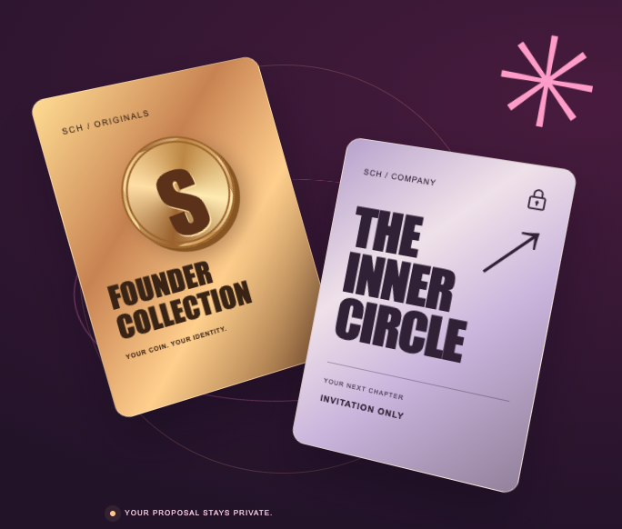
SCHALLERN
PRIVATE INVESTOR CIRCLE
BACK THE GAME.
BUILD THE COMPANY.
Founder NFTs + company equity
€20,000+
Planned minimum investment
Application → review → individual proposal
Two separately defined rights. Company equity and NFT profit rights do not double-count the same earnings.
11
Notes:
Planned combined investment proposal, not an automatic co-founder title or a double-return promise. NFTs and company equity have distinct rights. The company value is based on its own retained profit share; the NFT pool receives the other half. The full $150k equity round buys 13.6364% at $950k pre-money. The public mockup keeps packages private.
Sources: 03_Ergebnisse/Investoren_Pakete/03_PREIS_UND_RUECKFLUSS.md; Mint_Website_Plan/Mockups/E_Flip_The_World/Vorschau/Investors_EN_1440.png

Slide 12
SCHALLERN
YOUR NEXT MOVE
SMALL CHANGE.
BIG NEXT CHAPTER.
Experience the demo. Meet Kai.
Explore your place in Schallern.
REQUEST A PRIVATE INVESTOR CONVERSATION →
Meet Kai: calendly.com/zimmerkai/30min · Community: discord.gg/FpZ5zDjV4
12
Notes:
Primary CTA: a direct private conversation with Kai. The online viewer links to the current website and demo. The Calendly link offers the existing 45-minute video call; Discord provides the public community route. Private pricing and packages follow as two optional discussion pages, not public website content.
Sources: User conversation, investor section instructions

Slide 13
SCHALLERN
APPENDIX 01 / PRIVATE DISCUSSION
10,000 NFTs. DEFINED RIGHTS.
Units: 2,000 / 1,000 / 2,000 / 2,000 / 2,000 / 1,000
$1.55m NFT funding + $150k equity = $1.7m total
USD price plan. At $100/SOL: 0.75–2.50 SOL. Equal NFT profit rights; no automatic company shares. Later tiers need demand evidence.
13
Notes:
Public total: $1.4m for 8,000 units; mean $175. Angel: 2,000 × $75 = $150k. Company capital $150k is additional and purchases equity only. SOL $100 is a fixed sensitivity, not a current-price claim. Proposed angel lockup: twelve months. This supersedes the separate 0.5–2 SOL website concept for financial purposes.
Sources: 03_Ergebnisse/Investoren_Pakete/03_PREIS_UND_RUECKFLUSS.md

Slide 14
SCHALLERN
APPENDIX 02 / PRIVATE DISCUSSION
TWO RIGHTS. ONE PROPOSAL.
Budget | Company capital | NFTs | Company stake
Entry €20,000 | €10,000 | 146 | 1.00%
Bronze €25,000 | €12,500 | 183 | 1.25%
Silver €50,000 | €25,000 | 366 | 2.50%
Gold €100,000 | €50,000 | 733 | 5.00%
Platinum €200,000 | €100,000 | 1,466 | 10.00%
$950k pre-money + $150k equity = $1.1m post-money
Proposed terms, at full equity round. Assumed EUR/USD 1.10. Round caps: 2,000 angel NFTs and $150k equity. Whole NFTs only; unused budget is not charged.
14
Notes:
Total equity at full round: 13.6364%. Each package is an alternative use of the same remaining allocation, not independently additive. Platinum plus Gold exceeds both caps. Actual payments: entry €19,954.55; Bronze €24,977.27; Silver €49,954.55; Gold €99,977.27; Platinum €199,954.55. 50% of budget buys equity; up to 50% buys whole $75 NFTs. The $950k anchor is a proposal contingent on the described total funding and defined NFT rights. No equity cash dividends forecast in years 1–3.
Sources: 03_Ergebnisse/Investoren_Pakete/Aktuelle_Investoren_Pakete.csv; 03_Ergebnisse/Investoren_Pakete/03_PREIS_UND_RUECKFLUSS.md

